Slide 1
Pan genome analysis

Slide 2
PRESENTED BY:
APARNA S (21107)
G V ROHAN (21113)
HARSHITHA M(21115)
K SAITEJA (21122)
M SRAVANI (21125)

Slide 3
INTRODUCTION
PAN-X is a web based environment for visualizing and analyzing microbial pan-genome data. The workflow first divides the genomes of many genomes into genes and then clusters the genes into orthologous groups. It uses these clusters to identify SNPs in core genome.
The Pan-genome which is often several times larger than the core genome is collection of all genes found in set of strains for example strains from one species.
Pan Genomes have been created using a variety of software applications and pipelines.

Slide 4
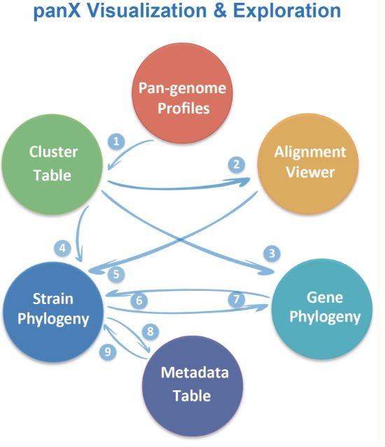
PAN-X
PAN-X is a set of tools for thorough examination, dynamic exploration, interactive visualization of bacterial genomes. The visualization application consists of number of related parts(statistical charts, gene cluster tables, alignment, comparative phylogenesis and metadata). The species tree can be used to map metadata and patterns of gene presence and absence. This mapping makes it easier to find genes linked to traits like antibiotic resistance, host age.
The species tree can be used to map metadata and patterns of gene presence and absence. Such mapping makes it easier to find genes linked to traits like virulence, antibiotic resistance, or epidemiological factors like host age.

Slide 5
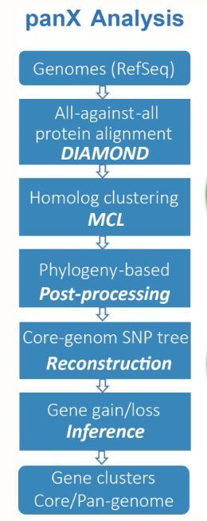
PAN-X ANALYSIS

Slide 6
METHODOLOGY
DATA COLLECTION
Go to NCBI and search the Porphyromonas gingivalis(main genome)
Download the Porphyromonas gingivalis fasta file.
Download the its Porphyromonas gingivalis strains also like 5 strains.
SNP CALLING
ALGORITHM:
Load the Porphyromonas gingivalis fasta file and read the entire sequence as seq_a
Then the one of the strain as fasta file and read the entire sequence as seq_b.
Convert the sequences in tupples and compare by using zip.
By using for loop find the mutations.

Slide 7
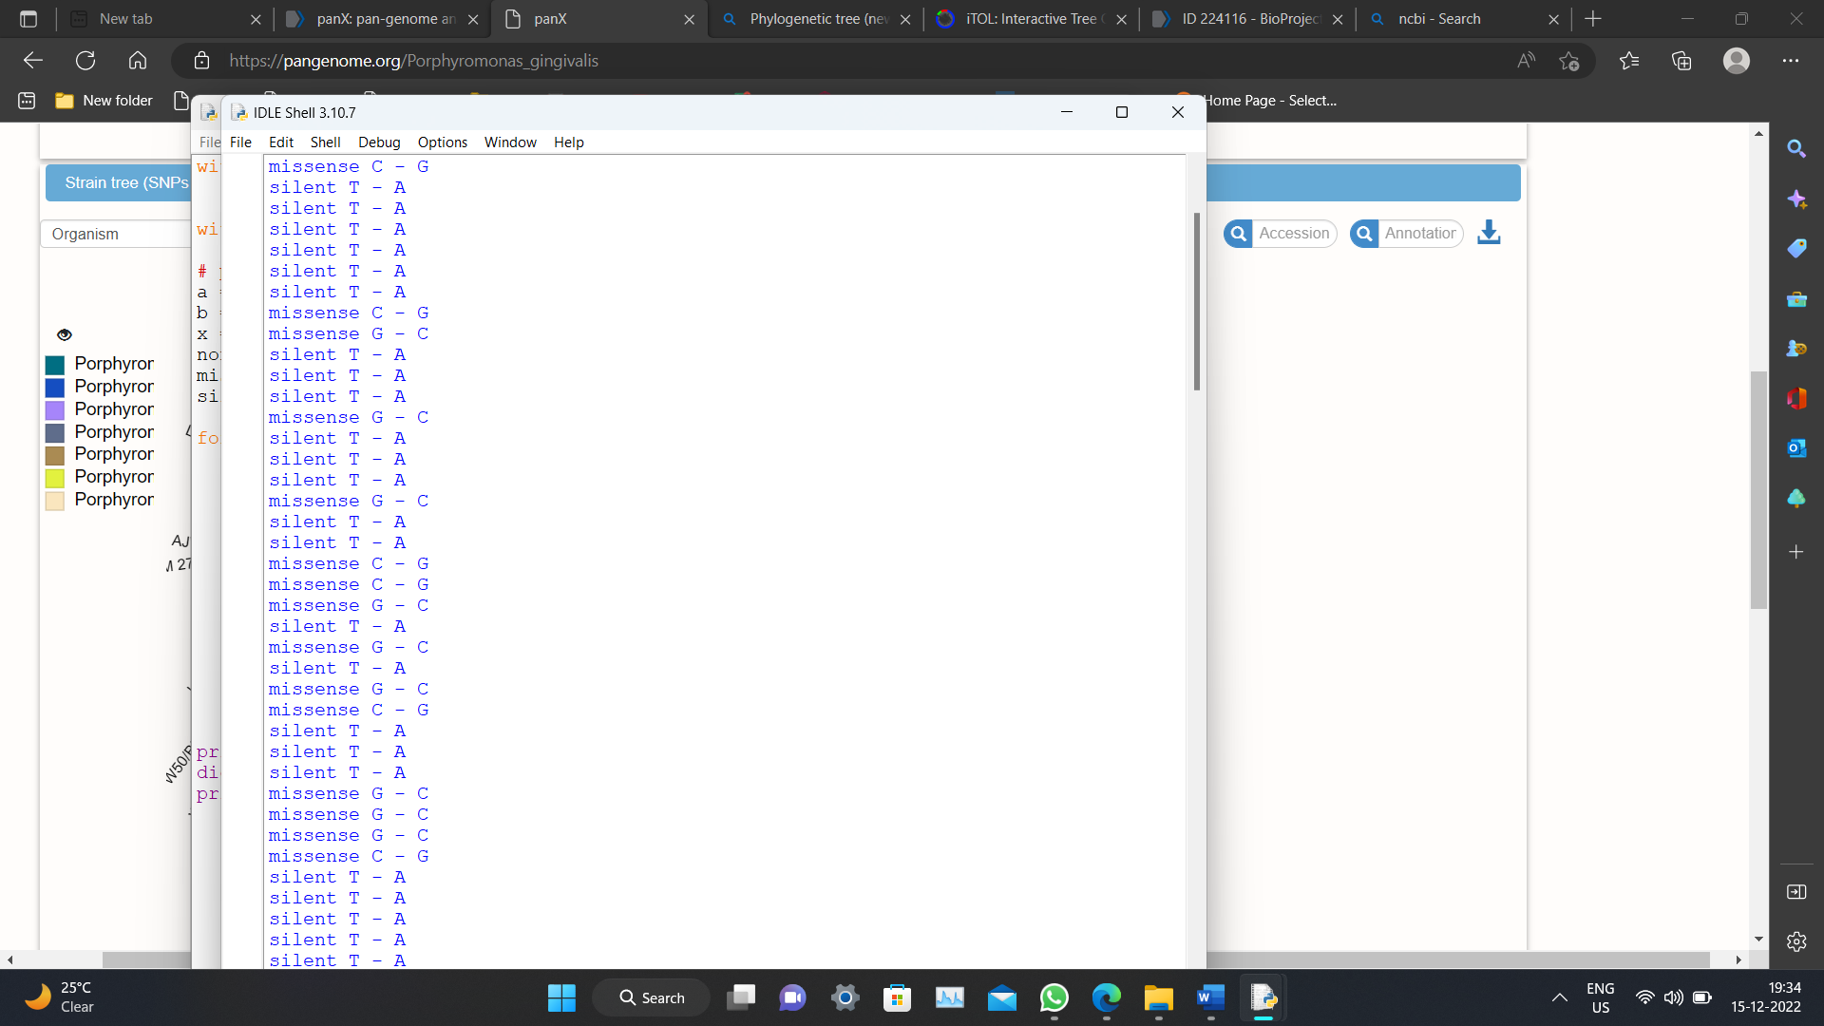
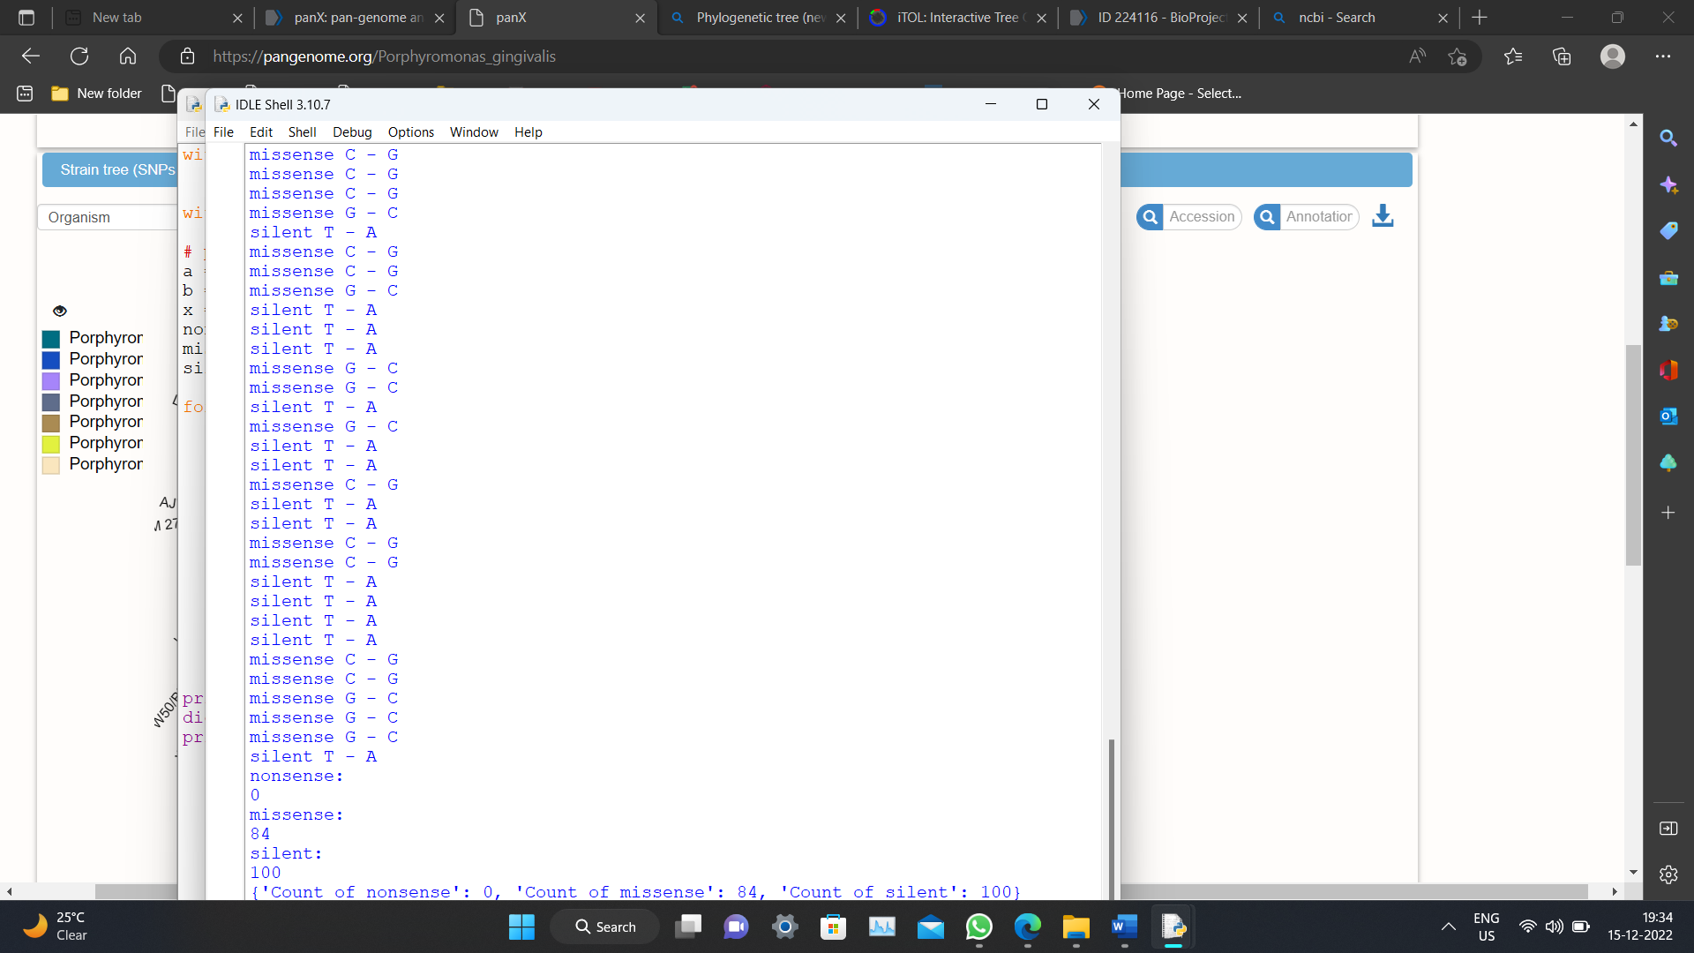
OUTPUT:

Slide 8
Core genome SNP tree
To create a core-genome SNP matrix, PanX extracts all variable locations from the nucleotide alignments of all single-copy core genes. Using FastTree and RaxML, this SNP matrix is used to create a core genome phylogenetic tree, which is then further improved, using a method similar to that employed in nextflu. This core genome tree may not accurately depict the history of each gene in the core genomes due to homologous recombination, and as only variable sites were employed, branch lengths do not correspond to sequence similarity. The distribution of phenotypes and the evolution of the mobile genome may both be studied using this core genome SNP phylogeny as a scaffold. It is nevertheless a fair approximation of the relationships between the many strains

Slide 9
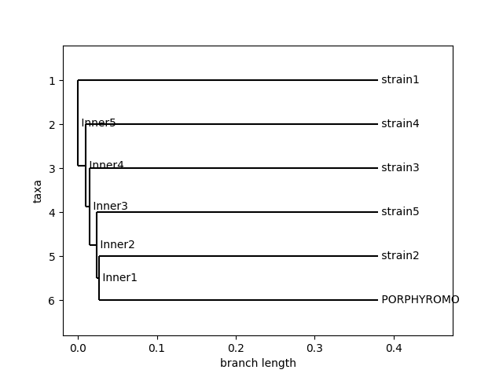
PHYLOGENETIC TRESS:
ALGORITHM:
First find the alignment between the porphyromonas gingivalis and strains.
Convert it into .phy and .phylip (All the genes of different strains and Porphyromonas gingivalis in same length.)
Calculate the distance matrix and distance tree.
From the distance tree construct the plygonetic tree using UPGMA algorithm.
Input:
Porphyromonas gingivalis and strains alignment.
Output:

Slide 10
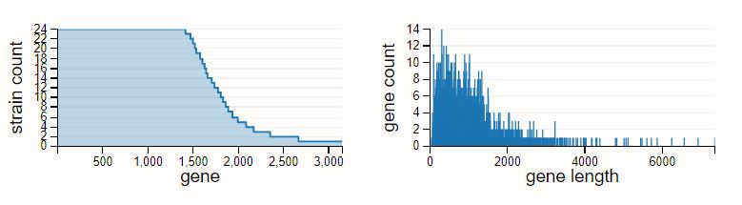
PAN-GENOME ANALYSIS:
We used an online tool for pan genome anlysis we
http://pgaweb.vlcc.cn
Input :
Porphyromonas gingivalis and strains.
Output :
Based on the length of genome :

Slide 11
CLUSTER POST-PROCESSING STAGE
In the cluster post-processing stage, phylogenetic trees for a gene cluster have already been inferred. Using these trees and the joint maximum likelihood method as implemented in tree time, PanX uses these trees to infer the ancestral sequences of internal nodes. This ancestral reconstruction is used to map the branches of the tree with likely mutations.

Slide 12
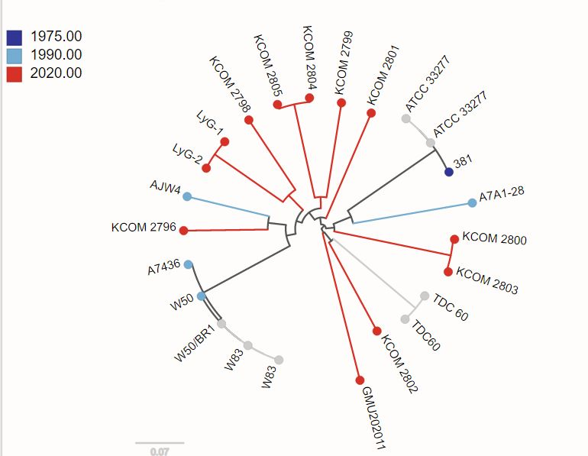
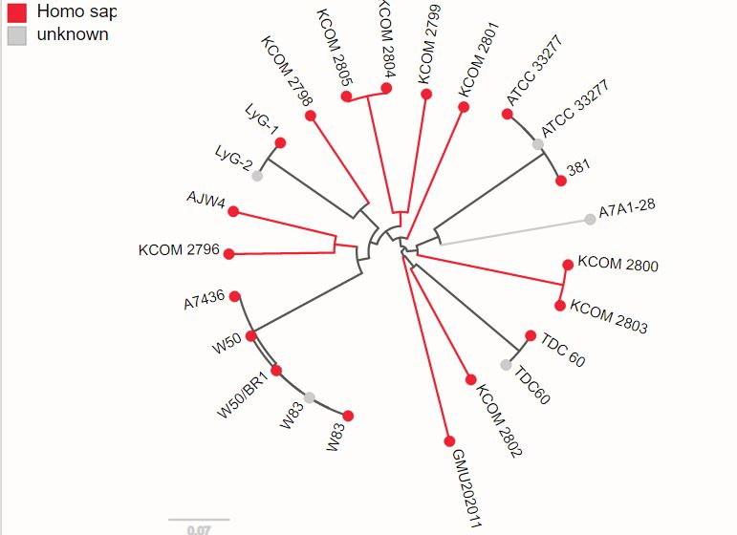
Data collection
Host

Slide 13
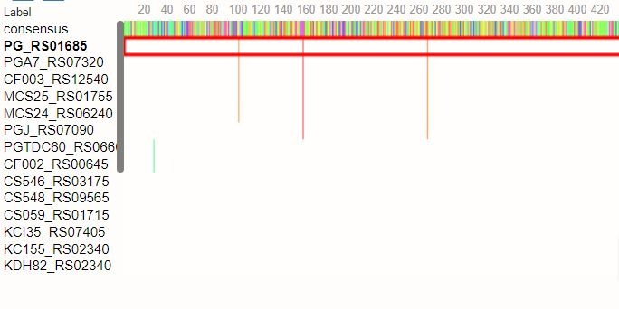
CONCERNCES :

Slide 14
CONCLUSION:
Large collections of bacterial genomes, which are characterized by the evolution of specific genes as well as the gain and loss of genes, are intended to be explored using PanX. It is designed to prioritize combining breadth and depth; in addition to summary statistics and species trees, it also allows users to choose particularly interesting groupings of genes or do gene-specific searches. Individual mutations and gain/loss events can then be mapped to the gene tree and the core tree, respectively, allowing for detailed analysis of alignments and phylogenetic trees of genes.
The meta-data, such as resistance characteristics connected to the various strains, can then be compared to the evolutionary patterns of genes. It can help studies by combining meta-data with the molecular evolution of genes and genomes in one visualization or its derivatives might be used to track food-borne epidemics, follow the global spread of drug-resistant bacteria, or help with infection management with the rising availability and prompt publishing of such data from routine surveillance.

Slide 15
THANK YOU!

